Slide 1
SEXUALLY TRANSMITTED DISEASES AND TUMOURS OF RH
BY Anjao Amdany
BScN/KRCHN

Slide 2
Content
Classification of STI according to syndrome
Rational for syndromic management
Common complication of STI
WHO flow chart for STI syndromes
Reproductive cancer

Slide 3
Classification of STI according to syndrome
Syndrome – is group of symptoms patient complains about and clinical signs you observe during examination
Different organisms that cause STIs give rise to only limited number of syndromes
There are seven syndromes (aim is to identify and manage accordingly)

Slide 4
Identifying Syndromes
SYNDROME | MOST COMMON CAUSE
Vaginal discharge | Vaginitis (Trichomoniasis, Candidiasis, Bacterial Vaginitis) Cervicitis (Gonorrhea, Chlamydia)
Urethral discharge | Gonorrhea, Chlamydia
Genital ulcer | Syphilis, Chancroid, Herpes
Lower abdominal pain | Gonorrhea, Chlamydia, Mixed Anaerobes
Scrotal swelling | Gonorrhea, Chlamydia
Inguinal bubo | Lymphogranuloma venereum (LGV), Chancroid
Neonatal conjunctivitis | Gonorrhea, Chlamydia
Notes:
Lymphogranuloma venereum (LGV) is a disease caused by 3 unique strains of Chlamydia trachomatis and characterized by a small, often asymptomatic skin lesion, followed by regional lymphadenopathy in the groin or pelvis. Alternatively, if acquired by anal sex, it may manifest as severe proctitis.

Slide 5
Clinical features
Vaginal itching and/or discharge
Intermenstrual bleeding
Penile discharge & scrotal pain and fullness
Urethral discharge
Painful sex or urination
Pelvic and abdominal pain
Chancre sores (painless/ painful) -genital area, anus, tongue and/or throat
Small blisters on the genital area
Soft, flesh-colored warts around the genital area

Slide 6
Clinical features cont…
Swollen glands, fever and body aches
Unusual infections, unexplained fatigue, night sweats and weight loss
A scaly rash on the palms and the soles
Itching skin, pain or abnormal tingling sensation at the site of infection
Yellow eyes and skin, pruritus
Dysuria, urinary frequency and/or urgency
Hepatosplenomegaly

Slide 7
Sti according to sydromes
Discharge syndromes
Those that produces discharge.eg. Gonorrhoea, non gonococcal urethritis, post gonococcal urethritis, vaginitis, candidiasis, trichomoniasis
Ulcerative syndromes
Those infections that produces papular or skin ulcer lesions eg.herpes simplex,syphillis and chancroid

Slide 8
CONT….
Non ulcerative syndromes
Scabies, venereal warts, crab lice
Others
e.g.. Hepatitis B, Infections mononucleosis, and HIV/AIDS

Slide 9
Why Syndromic Approach
STI sign and symptoms are rarely specific to a particular causative agent
Laboratories are either non-existent or non-functional due to lack of resources
Dual infections are quite common and both clinician and laboratory may miss one of them
Waiting time for lab. results may discourage some patients
Failure of cure at first contact

Slide 10
Key features of syndromic management
Problem oriented (responds to patient’s symptoms )
Highly sensitive and does not miss mixed infections
Treats the patient at first visit
Can be implemented at primary health care level
Use flow charts with logical steps
Provides opportunity and time for education and counseling

Slide 11
The five steps in syndromic STI case management
History taking and examination
Syndromic diagnosis and treatment, using flow charts
Education and counseling on HIV testing and safer sex, including condom promotion and provision
Management of sexual partners
Recording and reporting

Slide 12
Rational for syndromic mgt
Effective management of STI is one of the cornerstones of STI control.
Prevents the development of complications and sequelae
Decreases the spread of these diseases in the community
Offers a unique opportunity for targeted education about HIV prevention.
Appropriate treatment of STI patients at their first encounter is an important public health measure.
Potential to influence future sexual behaviour and treatment-seeking practices at a critical stage of development of adolescents when they are involved as clients

Slide 13
CONT..
The use of appropriate standardized protocols is strongly recommended
Ensures adequate treatment at all levels of the health service.
Facilitates the training and supervision of health providers
Delays the development of antimicrobial resistance in sexually transmitted agents e.g. N. gonorrhoeae and H. ducreyi (Chancroid).
An important factor in rational drug procurement

Slide 14
Complications
Men
Urethritis, Epididymitis, Proctitis, Urethral strictures
Women
Cervicitis, Pelvic Inflammatory Disease(PID)
Ectopic (tubal) pregnancy, Premature birth
Both Sexes
Infertility, Urethral fistulas, Blindness
Genital Elephantiasis, Frozen Pelvis
Meningitis, Intestinal obstruction and/or perforation

Slide 15
Flow charts for each of the STI syndromes
flow charts have been developed for each syndrome
urethral discharge,
vaginal discharge,
lower abdominal pain,
genital ulcer disease and
ophthalmia neonatorum

Slide 16
Syndrome 1: urethral discharge

Slide 17
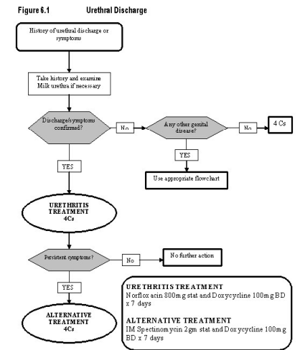

Slide 18
SYNDROME 2: Vaginal discharge
Patient complains of vaginal discharge, vulval itching or burning
Take history and examine
Assess risk¹
Abnormal vaginal discharge or vulval eryrthema?
Any other genital disease?
Educate and counsel
Promote condom use and provide condoms
Offer HIV counselling and testing if both facilities are available
No
No
Yes
Use appropriate flowchart for additional treatment
Yes
Lower abdominal tenderness?
No
High GC/CT prevalence setting² or risk assessment positive?
No
TREAT FOR BACTERIAL VAGINOSIS AND TRICHOMONAS VAGINALIS
Yes
Yes
Use flowchart for lower abdominal pain
TREAT FOR GONOCOCCAL INFECTION, CHLAMYDIA TRACHOMATIS, BACTERIAL VAGINOSIS AND TRICHOMONAS VAGINALIS.
Vulval oedema/curd-like discharge, erythema, excoriations present?
No
Educate and counsel
Promote condom use and provide condoms
Offer HIV counselling and testing if both facilities are available
Yes
¹ Risk factors need adaptation to local social, behavioural and epidemiological situation.
² The determination of high prevalence levels needs to be made locally.
TREAT FOR
CANDIDA ALBICANS
Source WHO, 2003

Slide 19
Vaginal discharge: Bimanual & speculum, with or without microscope
Patient complains of vaginal discharge, vulval itching or burning
Take history and examine patient
(external, speculum and bimanual)
Assess risk¹
Perform wet mount microscopy of vaginal specimen for TV and yeast cells (optional)
Lower abdominal tenderness or cervical motion tenderness present?
Yes
Use flowchart for lower abdominal pain
No
Cervical mucopus or erosions or
High GC/CT prevalence setting² or
risk assessment positive?
Source WHO, 2003
No
TREAT FOR BACTERIAL VAGINOSIS AND TRICHOMONAS VAGINALIS
Educate and counsel
Promote condom use and provide condoms
Offer HIV counselling and testing if both facilities are available
-------------------------------------
Manage and treat partner if cervical mucopus present
Manage and treat partner if microscopy demonstrates TV
Yes
TREAT FOR GONOCOCCAL INFECTION, CHLAMYDIA TRACHOMATIS, BACTERIAL VAGINOSIS AND TRICHOMONAS VAGINALIS.
Vulval oedema/curd-like discharge, vulval erythema, excoriations present or yeast cells on microscopy?
No
¹ Risk factors need adaptation to local social, behavioural and epidemiological situation
² The determination of high prevalence levels needs to be made locally
Yes
TREAT FOR
CANDIDA ALBICANS

Slide 20
Vaginal discharge: Bimanual, speculum & microscope
Patient complains of vaginal discharge, vulval itching or burning
Take history and examine patient (external, speculum and bimanual)
Assess risk¹
Lower abdominal tenderness or cervical motion tenderness present?
Yes
Use flowchart for lower abdominal pain
No
Cervical mucopus or erosions or
High GC/CT prevalence setting² or
risk assessment positive?
No
Yes
TREAT FOR GONOCOCCAL INFECTION AND CHLAMYDIA TRACHOMATIS
plus
vaginal infection according to speculum and microscope examination findings
Perform wet mount/Gram stain microscopy of vaginal specimen
Motile trichomonads
Clue cells seen plus pH>4.5 or KOH positive?
Budding yeasts or pseudohyphae seen
No abnormal findings
TREAT FOR TRICHOMONAS VAGINALIS
TREAT FOR BACTERIAL VAGINOSIS
TREAT FOR
CANDIDA ALBICANS
Educate and counsel • Promote condom use and provide condoms • Manage and treat partner • Offer HIV counselling and testing if both facilities are available • Ask patient to return if necessary
¹Risk factors need adaptation to local social, behavioural and epidemiological situation
² The determination of high prevalence levels needs to be made locally
Source WHO, 2003

Slide 21
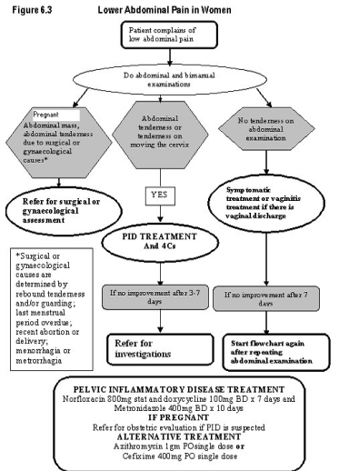
SYNDROME 2: Lower Abdominal Pain

Slide 22
GUD
Patient complains of a genital sore or ulcer
Take history and examine
Educate and counsel
Promote condom use and provide condoms
Offer HIV counselling and testing if both facilities are available
Only vesicles present?
No
Sore or ulcer present?
No
Yes
Yes
TREAT FOR HSV2.
TREAT FOR SYPHILIS IF INDICATED¹
TREAT FOR SYPHILIS AND CHANCROID.
TREAT FOR HSV2²
Educate and counsel
Promote condom use and provide condoms
Offer HIV counselling and testing if both facilities are available
Ask patient to return in 7 days
Ulcer(s) healed?
No
Ulcer(s) improving?
No
Refer
Educate and counsel
Promote condom use and provide condoms
Manage and treat partner
Offer HIV counselling and testing if both facilities are available
Yes
Continue treatment for a further 7 days
¹indications for syphillis treatment
- RPR positive; and
- No recent syphilis treatment
² Treat for HSV2 where prevalence is 30% or higher, or adapt to local conditions

Slide 23
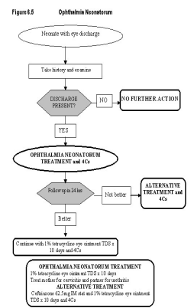

Slide 24
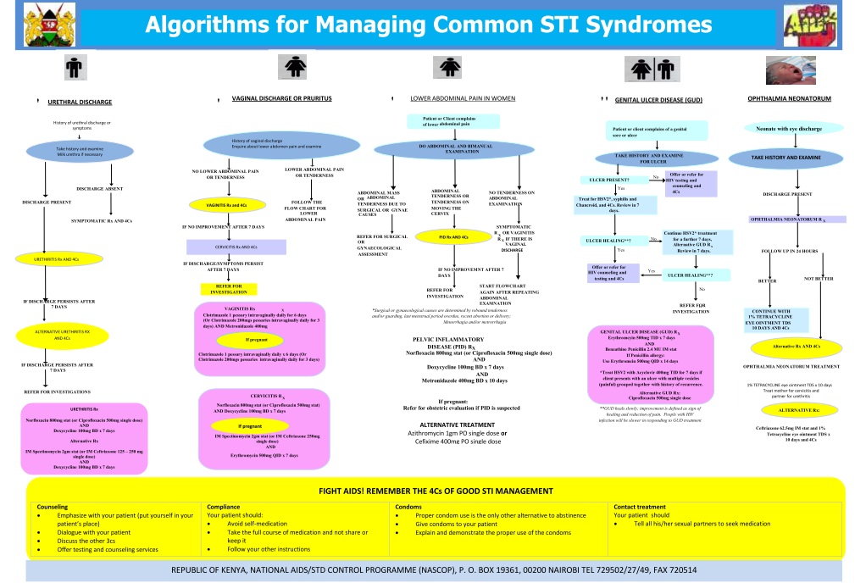

Slide 25
Reproductive cancers
Female reproductive cancer
vulvar cancer
vaginal cancer
cervical cancer
womb cancer
fallopian cancer
ovarian cancer

Slide 26
Cervical sreening
Two screening tests can help prevent cervical cancer or find it early—
The Pap test (or Pap smear) looks for precancers, cell changes on the cervix that might become cervical cancer if they are not treated appropriately.
The HPV test looks for the virus human papillomavirus that can cause these cell changes

Slide 27
Vulvar cancer
Vulvar cancer is a cancer that starts in the external female sex organs .It represent about 3% of all genital tract cancers in women.
90% of vulvar carcinomas are squamous cell carcinomas; and 90% of them are HPV related, and most common seen in relatively younger patients.
Non-HPV-related vulvar squamous cell carcinoma occurs in older women; It is well differentiated and unifocal.

Slide 28
Vaginal cancer
Vaginal cancer, sometimes referred to as primary vaginal cancer.It starts in the vagina.Extremely uncommon, usually occur in women older than age 60 years.
Represents 2-3% of Pelvic Cancers.84% of cancers in vaginal area are secondary
Risk factors are similar to those for carcinoma of the cervix
Associated with HPV infection in most cases

Slide 29
Vagina cancer Staging
Stage I:Confined to Vaginal Wall
Stage II:Subvaginal tissue but not to pelvic sidewall
Stage III: Extended to pelvic sidewall
Stage IVA:Bowel or Bladder
Stage IVB:Distant metastasis

Slide 30
Cervical cancer
Cervical cancer begins in the cervix (the neck of the womb), which is a strong muscle that forms the passage between the womb and the vagina.

Slide 31
Cervical carcinoma
Is one of the major causes of cancer-related deaths in women, despite improvements in early diagnosis and treatment.
The pap smear remains the most successful cancer screening test ever developed. Most studies have found that VIA, and its cousin VLI -- visual inspection with Lugol's iodine -- are somewhat less specific than Pap smears, but more sensitive. The general consensus is that VIA is just as useful as the Pap smear.

Slide 32
Risk factors
Risk factors for the development of CIN and invasive carcinoma are
Early age at first intercourse
Multiple sexual partners
Male partner with multiple previous sexual partners
Multiple birth
Chronic cervical infections

Slide 33
Stages of cancer progression
The pre-cancerous stage before the cells turn cancerous is called Cervical Intra-epithelial Neoplasia commonly in short called CIN

Slide 34
cont’d

Slide 35
Staging of cervical cancer

Slide 36
Uterine cancer
Also known as endometrial cancer. begins in the lining or walls of the uterus.

Slide 37
Leiomyoma
The most common benign tumor in females and are found in 30% to 50% of women during reproductive life. More frequent in blacks than in whites.
They are often referred to as fibroids because they are firm.
Estrogens and oral contraceptives stimulate their growth; conversely, they shrink postmenopausally.
They rarely transform into sarcomas.

Slide 38
Fallopian tubes cancer
Fallopian tube cancer begins in a woman’s fallopian tubes
Very rare genecology malignancy
5 years Survival is 56 %
Staging and treatment similar to ovarian cancer

Slide 39
Risk factors
Nulliparity
Chronic salpingistis
Infertility 70% cases
inflammatory disease (such as TB)

Slide 40
Staging of FTC
Stage I : confined to fallopian
Stage II : confined to pelvis
Stage III: extra pelvic disease
Stage IV: distant Metastasis

Slide 41
Ovarian cancer
Is cancer that forms in the tissue of the ovary

Slide 42
Ovarian cancer
It is the fifth most common cancer in US women. It is also the fifth leading cause of cancer death in women.
risk factors for epithelial ovarian cancers include
nulliparity
family history
infertile
anovulatory
habitual aborters
high-fat diet
exposure to industrial chemicals

Slide 43
Breast cancer
Breast cancer is sometimes considered a reproductive cancer too. It begins in the tissues that make up the breast.
The most common form of cancer in women worldwide It is easy to detect changes early through simple observation and manual breast examination.

Slide 44
Risk factors
Specific cause is unknown.
Most risk factors (approx 90%) are modifiable and are mainly environmental and life-style related; while the rest (5% to 10%) are genetic.
Female sex
Age
Family history of breast cancer
Prolonged exposure to oestrogens

Slide 45
Screening for breast cancer involves
breast self examination (BSE),
Clinical breast examination (CBE) and
breast imaging (mammography and/or ultrasound scanning).
All of these forms of screening aim to detect breast lesions in their early stages

Slide 46
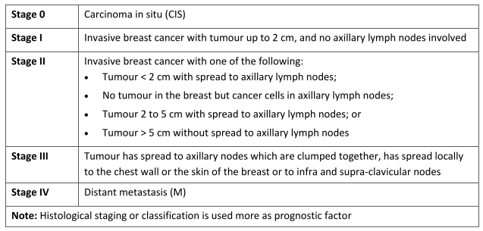

Slide 47
Breast Cancer: KEY MESSAGES
Cancer of the breast affects both men & women
It is more common in women
It is one of the most common cancers & very fatal if discovered late
It rarely occurs before 25 yrs of age but it is more common in clients 30 - 40s yrs of age with a peak at 40-50 yrs in our communities
Family history of ca breast is a strong etiological factor.

Slide 48
General Conclusion
Female Genital Tract Malignancy occur in each of the know anatomical segment : vulvar, vagina, cervix, uterus, fallopian and ovary
FGTM is common and cervical cancer is responsible for more deaths following by ovarian cancer then womb cancer
Option exist now for prevention, detection and treatment ,
Abnormal bleeding and discharge is the most common clinical manifestation
Surgery and chemotherapy are the main treatment option .

Slide 49
Reproductive cancers in men
The most common reproductive cancers in men are
Penile
Testicular
Prostate
There are no screening tests for testicular or penile cancer. It’s important for men to see a health care provider about any symptoms. Finding cancers early increases the chance of success.

Slide 50
screening tests for prostate cancer
There are two screening tests for prostate cancer
Prostate-Specific Antigen (PSA) test—blood test for PSA, a protein made by the prostate gland. Prostate cancer can increase the PSA level.
Digital Rectal exam

Slide 51
Risk factors
Testicular cancer: Undescended testicle, having a family history of testicular cancer, having a testicle that is not normal.
Penile cancer: HPV, being uncircumcised, being age 60 or older, having many sexual partners, using tobacco products.
Prostate cancer: Being aged 50 years old or older, having a family history of prostate cancer.

Slide 52
Symptoms
Each type of reproductive cancer has different symptoms
Penile—Redness, discomfort, a sore or a lump on the penis.
Testicular—Pain, discomfort, a lump or swelling in the testicle, aching in the lower abdomen (belly).
Prostate— Weak flow of urine, blood in urine, pain in the back, hips, or pelvis (lower belly between the hips), needing to pass urine often

Slide 53
Treatment
The treatment for male reproductive cancer depends on the type of cancer.
Reproductive cancers are often treated with surgery, chemotherapy , hormone therapy , radiation, or a combination used together.

Slide 54
Male Breast Cancer
Male breast cancer is rare, occurring mostly in older men.
frequency ratio to breast cancer in the female of 1:125.
Because of scant amount of breast substance in males, the tumor rapidly infiltrates the skin and underlying thoracic wall

Slide 55
Signs and Symptoms
The signs and symptoms of male breast cancer include
a painless lump or area of thickening on the pectoral region,
changes to the skin covering the breast, such as redness, dimpling, or scaling,
discharge from the nipple, or changes of the nipple, such as turning inward.
Diagnosis is made by a mammogram, ultrasound, and fine needle biopsy

Slide 56
Causes and risk factors
The exact cause of male breast cancer is not known.
Risk factors for male breast cancer include
older age (between 60 to 70 years),
exposure to estrogen-related medications,
family history of breast cancer,
genetic predisposition,
obesity,
radiation exposure,
Klinefeltner's syndrome, and liver disease

Slide 57
Treatment
The goal of treatment is to remove the tumor or growth the surrounding tissues and lymph nodes.
Additional treatment includes radiation therapy, chemotherapy, and hormone therapy.

Slide 58
Reference
WHO. (2004). Guidelines for Management of Sexually Transmitted Infections.
Republic of Kenya. MOH. NASCOP (2015). Algorithms for managing common STI Syndromes. Revised Chart for STI Management.
Kenya National Cancer Prevention and Control Act http://www.ipcrc.net/pdfs/Kenya-National-Cancer-Control-strategy.pdf [Accessed 1 Dec 2013]

Slide 59
Thank you

